Slide 1

Gradient Descent

Slide 2
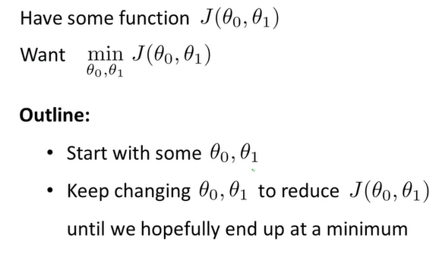

Slide 3
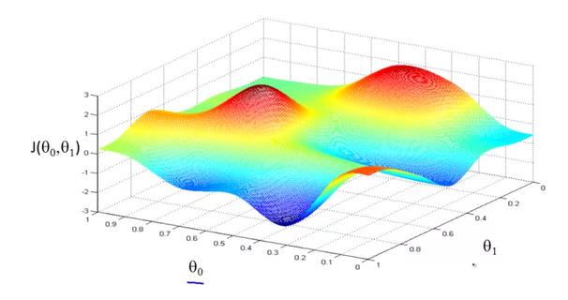
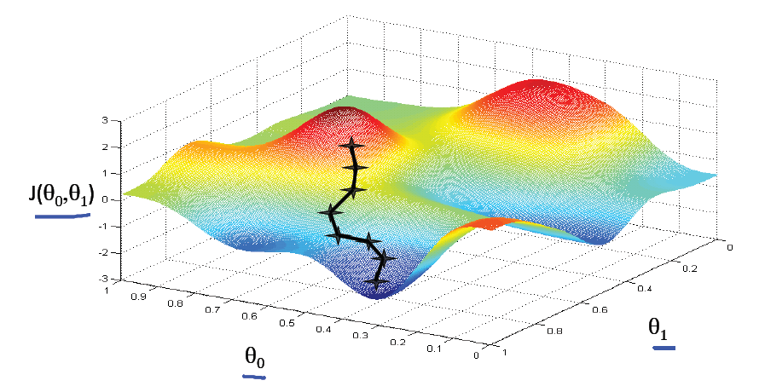
Example

Slide 4
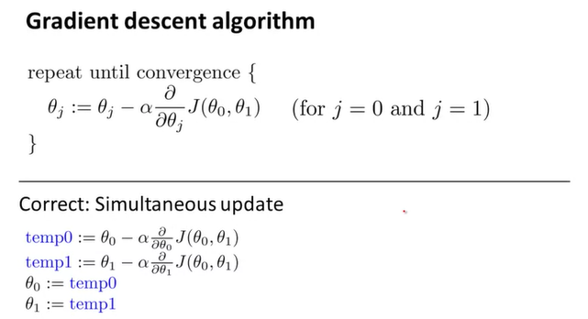

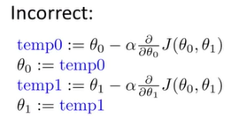
derivative
assignment
learning rate

Slide 5
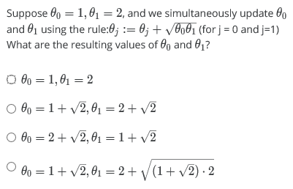
Example

Slide 6


More about the algorithm
Minimize J($θ_{1}$) $θ_{1}∈R$

Slide 7
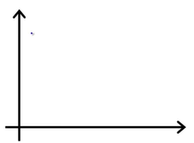




J($θ_{1}$)
≥0
(positive number)
$$θ_{1}$$
J($θ_{1}$)
≤0
(negative number)
$$θ_{1}$$

Slide 8
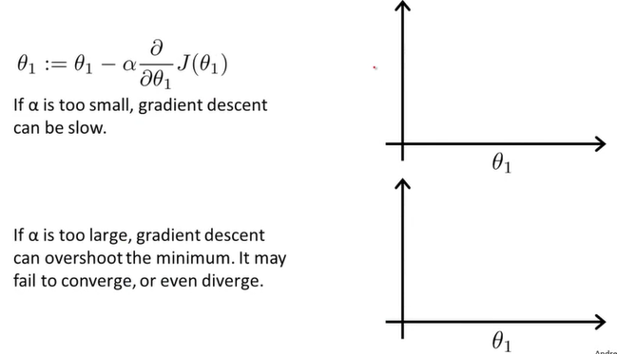


What about αlpha?
J($θ_{1}$)
J($θ_{1}$)

Slide 9
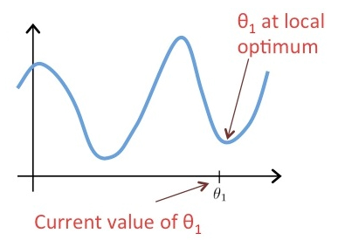
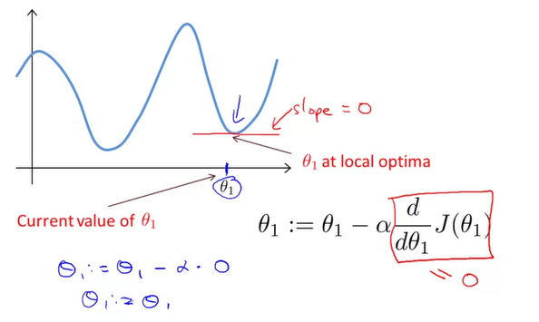
Another case

Slide 10
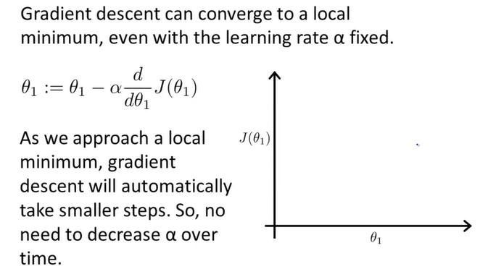
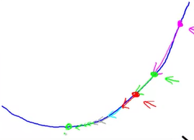
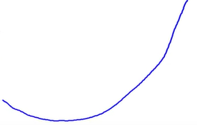

Advantage of Gradient Descent
J($θ_{1}$)

Slide 11
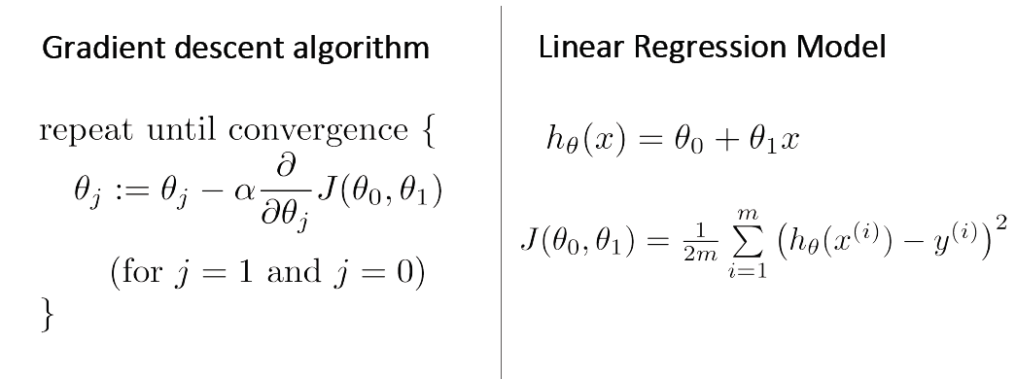

Gradient Descent for Linear Regression
Minimize J($θ_{0},θ_{1}$)

Slide 12


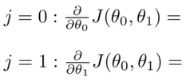
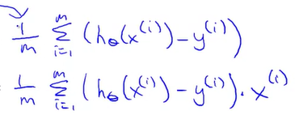

Gradient Descent for Linear Regression
=
$${(θ_{0}+θ_{1}x_{i}−y_{i}^{})}^{2}$$
?

Slide 13
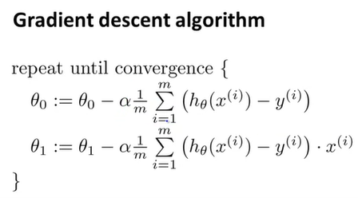
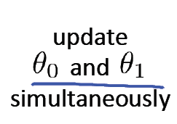


Gradient Descent for Linear Regression
$$\frac{∂}{∂θ_{0}}J(θ_{0},θ_{1})$$
$$\frac{∂}{∂θ_{1}}J(θ_{0},θ_{1})$$

Slide 14
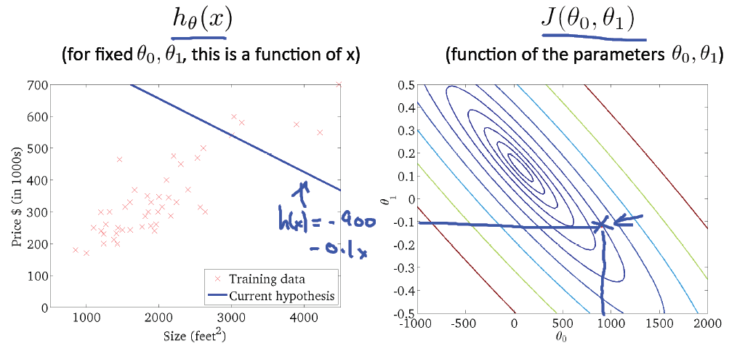
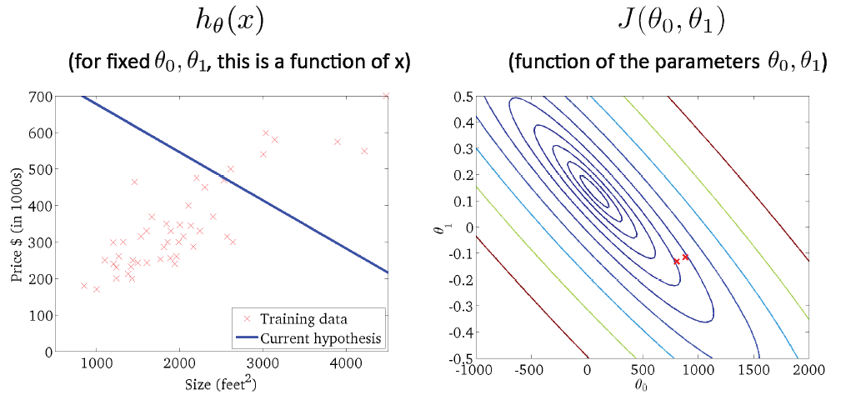

Slide 15
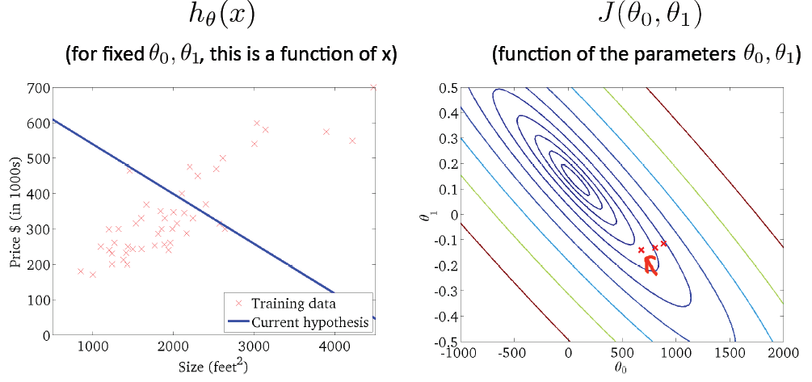
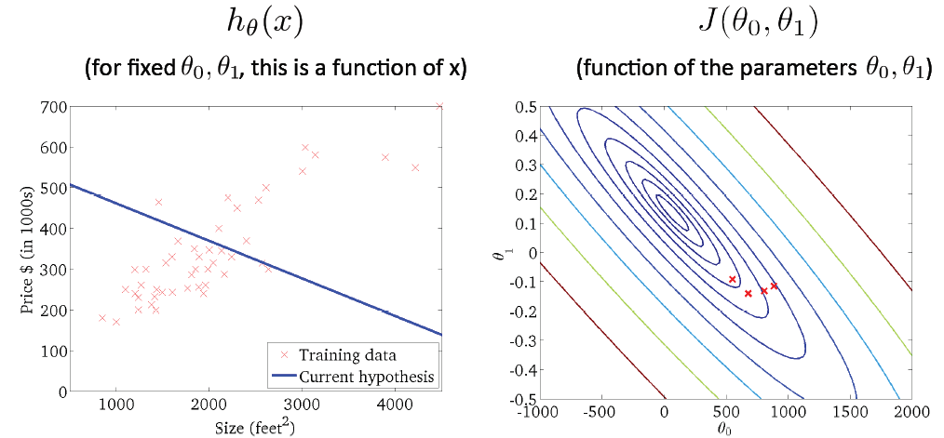

Slide 16
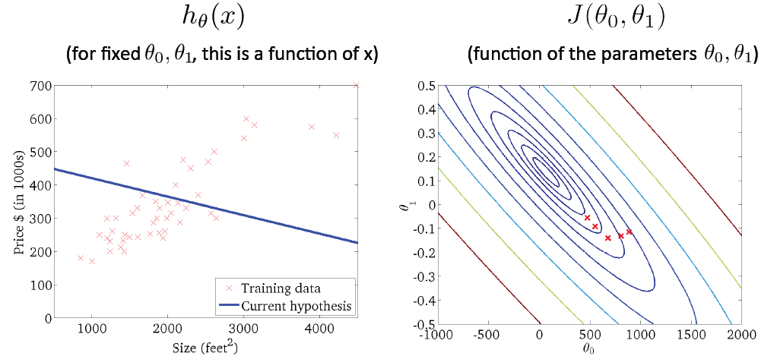
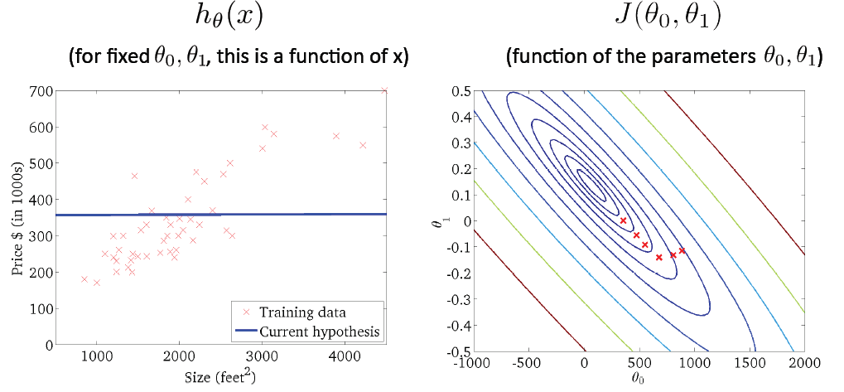

Slide 17
